Slide 1
COMMUNITY SERVICES

Slide 2
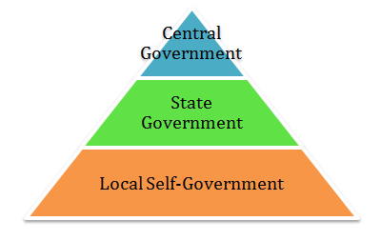
Different of levels of government in India are as follows:-
Central government
State government
Local self government

Slide 3
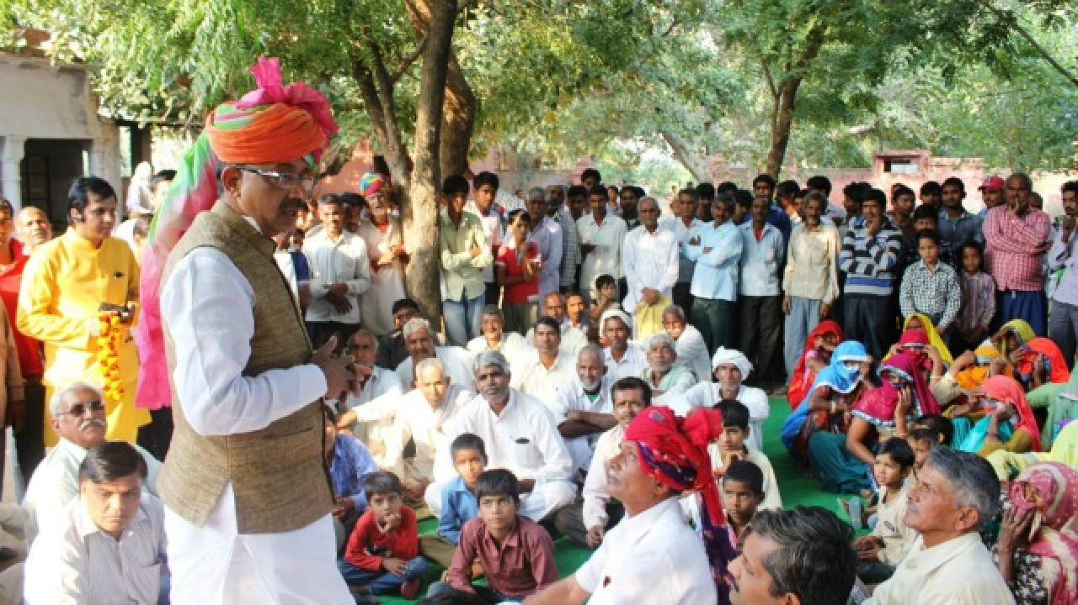
Local self-government at the rural level is Gram Panchayat.
It is elected for 5 years.
The head of the Gram Panchayat is called Sarpanch or Pradhan.
Any above 18 years of age can vote.
Local Self
Government

Slide 4
Functions of Local Self Government
Maintaining cleanliness of the village.
Planting tees, digging wells, lighting of streets.
Providing clean drinking water.
Setting up primary health centers.
Construction of building, streets and road.
Suppling seed and fertilizers to farmers, providing them knowledge about latest technology.
Setting up primary schools.
Establishing adult educational centers.
Settling disputes among villagers.

Slide 5
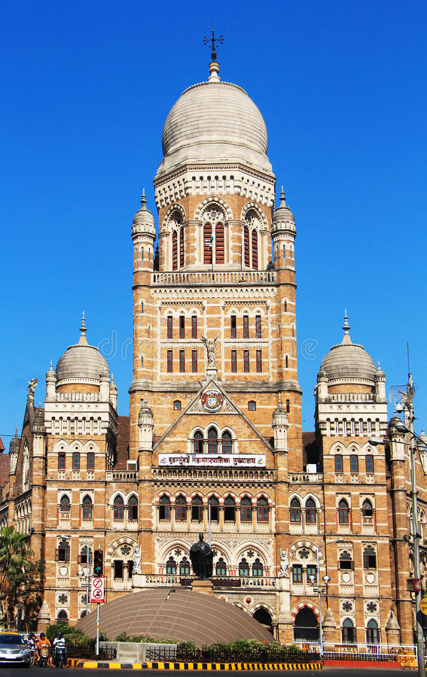
It is elected for 5 years.
The head of the Gram Panchayat is called Mayor.
Any above 18 years of age can vote.
Municipal Corporation

Slide 6
Functions of Municipality
Provide good living conditions for the people of a town or city.
Build and maintain roads and keep them clean.
Provide enough water for all daily needs.
Provide people with clean drinking water.
Set up schools, adult education centers and libraries.
Issuing of birth and death certificates.
Make parks and gardens and plant trees.
Build and maintain markets and public toilets..
Ensure supply of electricity to homes and lighting of the streets.

Slide 7
Our Duties to the government
It is the people's duty to cooperate with them as they work for the benefit of the community
as a whole.
We should pay our taxes on time.
We should follow law and order, keep roads and parks clean, not damaging public property etc.

Slide 8
Thank you
Asha Singh

